Slide 1

Lab 4

Slide 2
Lab Goal
Understanding and implementation of searching and sorting algorithms
Searching Algorithms to implement
Linear Search
Binary Search
Sorting Algorithms to implement
Merge Sort
Quick Sort

Slide 3
Code To Write
linearSearch(data, target)
binarySearch(data, target)
data: vector<T>
target: T
T = any given data type
Both functions should return an int of the index of the target in the vector
If the value is not in the vector, then return -1
Difference between these functions are the way they are implemented, and the data given for the binary search is always sorted

Slide 4
Code To Write (cont.)
mergeSort(lst)
quickSort(lst)
lst: vector<T>
T = any given data type
Both functions should sort the vector in a recursive manner and return a sorted version of the vector
Difference between these functions are the way they are implemented
Feel free to implement helper functions for these functions

Slide 5
Binary Search Example
{0,2,4,6,8,10,12,14,16,18,20,22,24,26}
Target = 18
lowIndex = 0
highIndex = 13
midIndex = (13 + 0) / 2 = 6
array[6] = 12
12 is less than 18 so increase lowIndex
lowIndex = 6 + 1 = 7

Slide 6
Binary Search Example (cont.)
{0,2,4,6,8,10,12,14,16,18,20,22,24,26}
Target = 18
lowIndex = 7
highIndex = 13
midIndex = (13 + 7) / 2 = 10
array[10] = 20
20 is greater than 18 so decrease highIndex
highIndex = 10 - 1 = 9

Slide 7
Binary Search Example (cont.)
{0,2,4,6,8,10,12,14,16,18,20,22,24,26}
Target = 18
lowIndex = 7
highIndex = 9
midIndex = (7 + 9) / 2 = 8
array[8] = 16
16 is less than 18 so increase lowIndex
lowIndex = 8 + 1 = 9

Slide 8
Binary Search Example (cont.)
{0,2,4,6,8,10,12,14,16,18,20,22,24,26}
Target = 18
lowIndex = 9
highIndex = 9
midIndex = (9 + 9) / 2 = 9
array[9] = 18
return 9 as the answer

Slide 9
Quick Sort Example
{22,14,8,6,10,2,12,16}
select a random index and set the value at that index as the pivot
In this example we will use 6 as the random index
pivotValue = 12

Slide 10
Quick Sort Example (cont.)
{12,14,8,6,10,2,22,16}
Swap that value with the first value
pivotValue = 12
pivotIndex = 0

Slide 11
Quick Sort Example (cont.)
{12,14,8,6,10,2,22,16}
Loop through the rest of the vector starting with the value after the pivot index
pivotValue = 12
pivotIndex = 0
If a value is less than the pivot value, then increase the pivotIndex and swap the value at the new pivotIndex with the value

Slide 12
Quick Sort Example (cont.)
{12,14,8,6,10,2,22,16}
pivotValue = 12
pivotIndex = 0
currentValue = 14
14 is greater than 12 so 14 stays where it is

Slide 13
Quick Sort Example (cont.)
{12,14,8,6,10,2,22,16}
pivotValue = 12
pivotIndex = 0
currentValue = 8
8 is less than 12 so increase the pivotIndex and swap 8 with the value at pivotIndex
pivotIndex = 0 + 1 = 1
{12,14,8,6,10,2,22,16} -> {12,8,14,6,10,2,22,16}

Slide 14
Quick Sort Example (cont.)
{12,8,14,6,10,2,22,16}
pivotValue = 12
pivotIndex = 1
currentValue = 6
6 is less than 12 so increase the pivotIndex and swap 6 with the value at pivotIndex
pivotIndex = 1 + 1 = 2
{12,8,14,6,10,2,22,16} -> {12,8,6,14,10,2,22,16}

Slide 15
Quick Sort Example (cont.)
{12,8,6,14,10,2,22,16}
pivotValue = 12
pivotIndex = 2
currentValue = 10
10 is less than 12 so increase the pivotIndex and swap 10 with the value at pivotIndex
pivotIndex = 2 + 1 = 3
{12,8,6,14,10,2,22,16} -> {12,8,6,10,14,2,22,16}

Slide 16
Quick Sort Example (cont.)
{12,8,6,10,14,2,22,16}
pivotValue = 12
pivotIndex = 3
currentValue = 2
2 is less than 12 so increase the pivotIndex and swap 2 with the value at pivotIndex
pivotIndex = 3 + 1 = 4
{12,8,6,10,14,2,22,16} -> {12,8,6,10,2,14,22,16}

Slide 17
Quick Sort Example (cont.)
{12,8,6,10,2,14,22,16}
pivotValue = 12
pivotIndex = 4
currentValue = 22
22 is greater than 12 so value stays where it is

Slide 18
Quick Sort Example (cont.)
{12,8,6,10,2,14,22,16}
pivotValue = 12
pivotIndex = 4
currentValue = 16
16 is greater than 12 so value stays where it is

Slide 19
Quick Sort Example (cont.)
{12,8,6,10,2,14,22,16}
pivotValue = 12
pivotIndex = 4
The loop is now done so swap the pivotValue with the number at the pivotIndex
{2,8,6,10,12,14,22,16}

Slide 20
Quick Sort Example (cont.)
{2,8,6,10,12,14,22,16}
pivotValue = 12
pivotIndex = 4
Now call quicksort on the two partitions
quicksort(list, 0, 3)
quicksort(list, 5, 7)
Because this is recursive make sure you produce some kind of base case to stop the quick sort

Slide 21
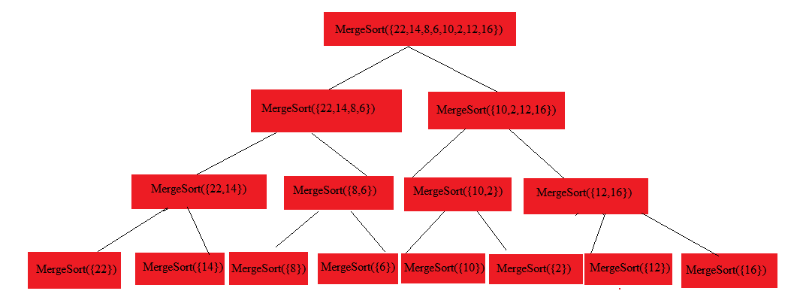
Merge Sort Example
{22,14,8,6,10,2,12,16}
Recursively call merge sort on vector until the part of the vector you are merge sorting is a size of 1

Slide 22
Merge Sort Example (cont.)
original = {22,14,8,6,10,2,12,16}
After MergeSort is called the two halves you called mergesort on should be sorted
You then need to merge the two lists together
So the top call of the merge sort will get back two sorted halves where
half1 = {6,8,14,22}
half2 = {2,10,12,16}

Slide 23
Merge Sort Example (cont.)
original = {22,14,8,6,10,2,12,16}
half1 = {6,8,14,22}
half2 = {2,10,12,16}
Start at the first value in each list
Whichever value is smaller put it in a new vector and move on to the next value in the list

Slide 24
Merge Sort Example (cont.)
original = {22,14,8,6,10,2,12,16}
half1 = {6,8,14,22}
half2 = {2,10,12,16}
2 is smaller so place it in the new vector
sorted = {2}

Slide 25
Merge Sort Example (cont.)
original = {22,14,8,6,10,2,12,16}
half1 = {6,8,14,22}
half2 = {2,10,12,16}
8 is smaller so place it in the new vector
sorted = {2,6,8}

Slide 26
Merge Sort Example (cont.)
original = {22,14,8,6,10,2,12,16}
half1 = {6,8,14,22}
half2 = {2,10,12,16}
10 is smaller so place it in the new vector
sorted = {2,6,8,10}

Slide 27
Merge Sort Example (cont.)
original = {22,14,8,6,10,2,12,16}
half1 = {6,8,14,22}
half2 = {2,10,12,16}
12 is smaller so place it in the new vector
sorted = {2,6,8,10,12}

Slide 28
Merge Sort Example (cont.)
original = {22,14,8,6,10,2,12,16}
half1 = {6,8,14,22}
half2 = {2,10,12,16}
14 is smaller so place it in the new vector
sorted = {2,6,8,10,12,14}

Slide 29
Merge Sort Example (cont.)
original = {22,14,8,6,10,2,12,16}
half1 = {6,8,14,22}
half2 = {2,10,12,16}
16 is smaller so place it in the new vector
sorted = {2,6,8,10,12,14,16}

Slide 30
Merge Sort Example (cont.)
original = {22,14,8,6,10,2,12,16}
half1 = {6,8,14,22}
half2 = {2,10,12,16}
Once an entire half has been exhausted place the rest of the other half in the sorted vector
sorted = {2,6,8,10,12,14,16, 22}
This example only shows the merging at the top level but it should be done like this for every call during the recursion

Slide 31
Some Hints
For the merge sort and the quick sort it might help to create a helper function similar to the following
MergeSort/QuickSort(lst, low, high)
lst : reference to list
low: int
Index of the lower bound to be sorted
high: int
Index of the upper bound to be sorted
Using this function you can sort the values of the list within the given range
This will prevent you from having to make several copies of the list during recursive calls

